Slide 1
Lecture 2
2021-2022
د طارق علي

Slide 2
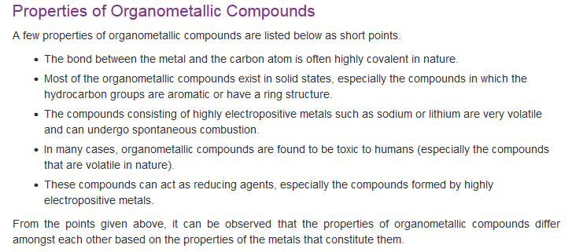

Slide 3
Reactions:
- ligand substitution
- oxidative addition/reductive elimination
migratory insertion/
β-elimination (carbo-, hydrometalation)
- alkene metathesis
- transmetalation

Slide 4
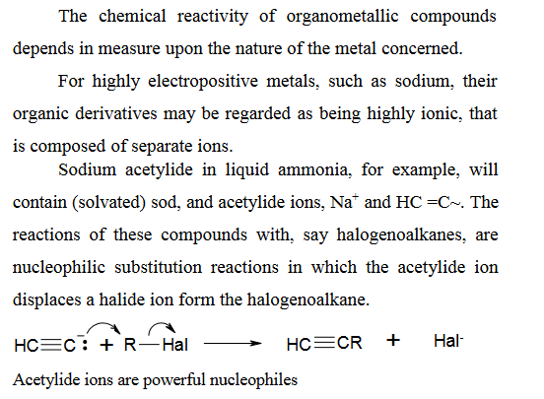

Slide 5
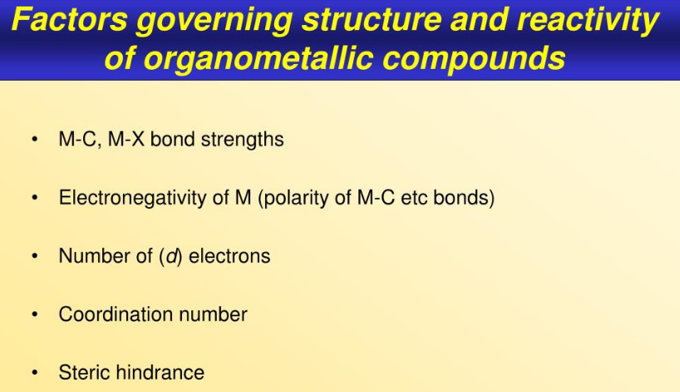

Slide 6
SYNTHETIC METHODS

Slide 7
SYNTHETIC METHODS
- ligand substitution: M-L + L’ → M-L’ + L
can be associative, dissociative, or radical chain.
trans-effect: kinetic effect of a ligand on the role of substitution at the position trans to itself in a square or octahedral complex (ground-state weakening of bond).
L → M, repels negative charge to trans position.

Slide 8
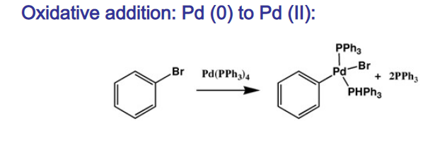
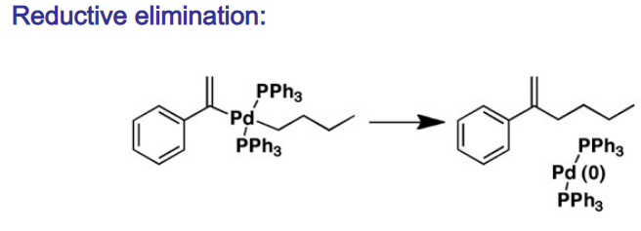

Slide 9
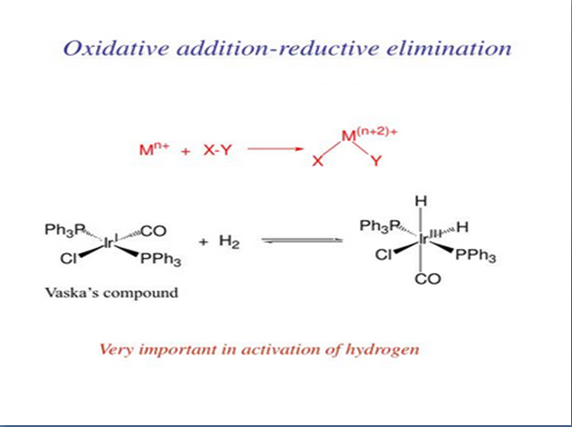

Slide 10
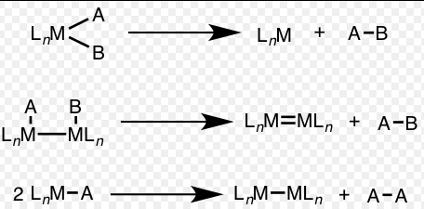
Reductive elimination is an elementary step in organometallic chemistry in which the oxidation state of the metal center decreases while forming a new covalent bond between two ligands. It is the microscopic reverse of oxidative addition, and is often the product-forming step in many catalytic processes. Since oxidative addition and reductive elimination are reverse reactions, the same mechanisms apply for both processes, and the product equilibrium depends on the thermodynamics of both directions

Slide 11
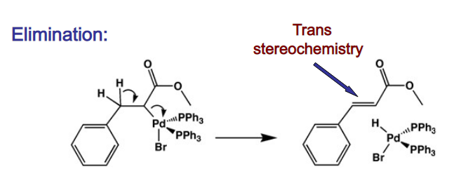

Slide 12
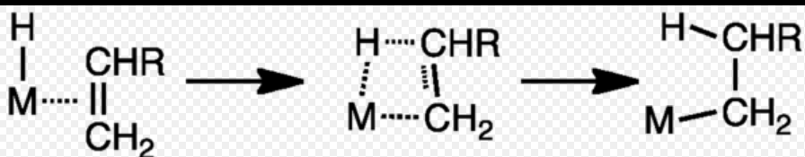
Insertion of alkenes into M–H bonds
The insertion of alkenes into metal-hydrogen bonds is a key step in hydrogenation
and hydroformylation reactions. The reaction involves the alkene and the hydride
ligands combining within the coordination sphere of a catalyst. In hydrogenation,
the resulting alkyl ligand combines with a second hydride to give the alkane.
Analogous reactions apply to the hydrogenation of alkynes:
an alkenyl ligand combines with a hydride to eliminate an alkene

Slide 13
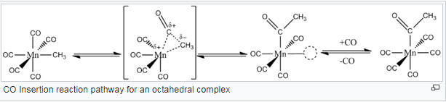
CO insertion
The insertion of carbon monoxide into a metal-carbon bond to form an acyl group is the basis of
carbonylation reactions, which provides many commercially useful products

Slide 14
- migratory insertion:

Slide 15
- β-elimination/hydrometalation:

Slide 16
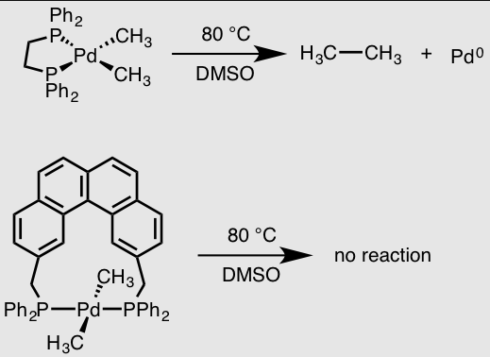

Slide 17

Hydrometalation (hydrometallation) is a type of chemical reaction in organometallic chemistry in which a chemical compound with a hydrogen to metal bond (M-H, metal hydride) adds to compounds with an unsaturated bond like an alkene (RC=CR) forming a new compound with a carbon to metal bond (RHC-CRM).^{[1]} The metal is less electronegative than hydrogen, the reverse reaction is beta-hydride elimination. The reaction is structurally related to carbometalation. When the substrate is an alkyne the reaction product is a vinylorganometallic.
Examples are hydroboration, hydroalumination, hydrosilylation and hydrozirconation.

Slide 18
- olefin metathesis:

Slide 19
Transmetalation is a type of organometallic reaction that involves the transfer of ligands from one metal to another. It has the general form:
  M₁–R + M₂–R′ → M₁–R′ + M₂–R
Redox-transmetalation[1-
  M₁^{n+}–R + M₂ → M₁ + M₂^{n+}–R.
In redox-transmetalation a ligand is transferred from one metal to the other through an intermolecular mechanism. During the reaction one of the metal centers is oxidized and the other is reduced. The electronegativities of the metals and ligands is what causes the reaction to go forward. If M₁ is more electronegative than M₂, it is thermodynamically favorable for the R group to coordinate to the less electronegative M₂.

Slide 20
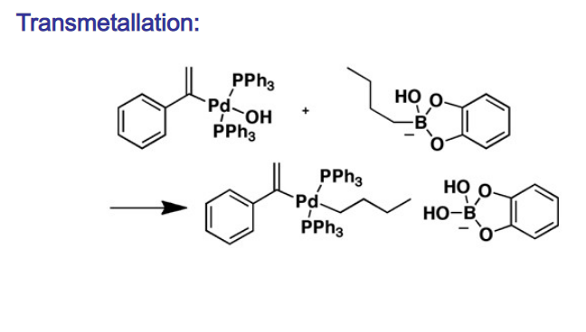
2-Redox-transmetalation/ligand-exchange
M₁–R + M₂–X → M₁–X + M₂–R.
In redox-transmetalation/ligand exchange the ligands of two metal complexes switch
places with each other, bonding with the other metal center.
The R ligand can be an alkyl, aryl, alkynyl, or allyl group and the X ligand can be a halogen,
pseudo-halogen, alkyl, or aryl grou

